Slide 1
Mixed Analysis of Variance Models with SPSS
Robert A.Yaffee, Ph.D.
Statistics, Social Science, and Mapping Group
Information Technology Services/Academic Computing Services
Office location: 75 Third Avenue, Level C-3
Phone: 212-998-3402

Slide 2
Outline
Classification of Effects
Random Effects
  Two-Way Random Layout
  Solutions and estimates
General linear model
  Fixed Effects Models
    The one-way layout
Mixed Model theory
    Proper error terms
Two-way layout
Full-factorial model
  Contrasts with interaction terms
  Graphing Interactions

Slide 3
Outline-Cont’d
Repeated Measures ANOVA
Advantages of Mixed Models over GLM.

Slide 4
Definition of Mixed Models by their component effects
Mixed Models contain both fixed and random effects
Fixed Effects: factors for which the only levels under consideration are contained in the coding of those effects
Random Effects: Factors for which the levels contained in the coding of those factors are a random sample of the total number of levels in the population for that factor.

Slide 5
Examples of Fixed and Random Effects
Fixed effect:
Sex where both male and female genders are included in the factor, sex.
Agegroup: Minor and Adult are both included in the factor of agegroup
Random effect:
  Subject: the sample is a random sample of the target population

Slide 6
Classification of effects
There are main effects: Linear Explanatory Factors
There are interaction effects: Joint effects over and above the component main effects.

Slide 7
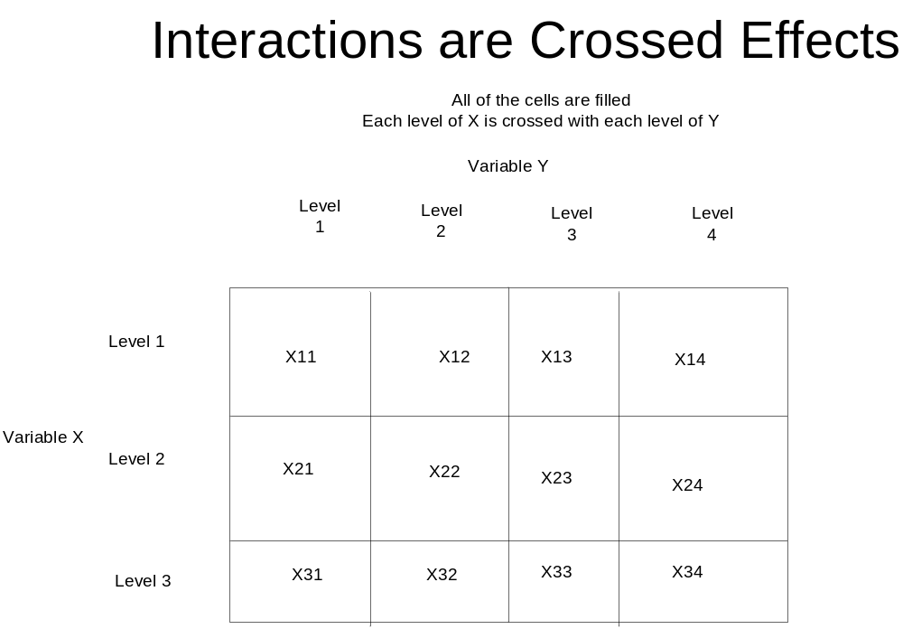

Slide 8
Classification of Effects-cont’d
Hierarchical designs have nested effects. Nested effects are those with subjects within groups.
An example would be patients nested within doctors and doctors nested within hospitals
This could be expressed by
patients(doctors)
doctors(hospitals)

Slide 9
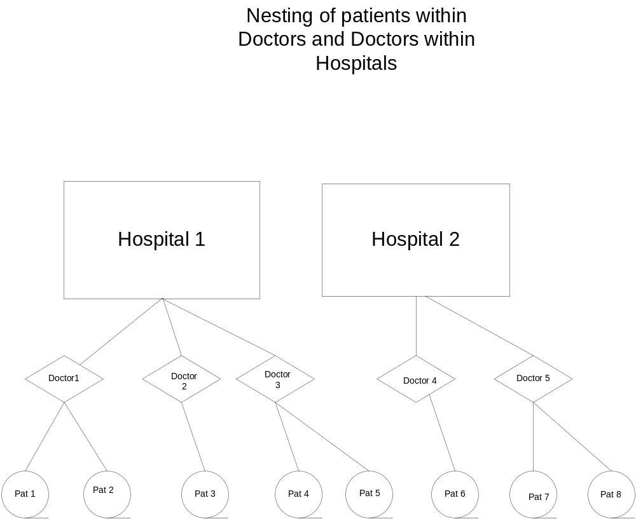

Slide 10
Between and Within-Subject effects
Such effects may sometimes be fixed or random. Their classification depends on the experimental design
Between-subjects effects are those who are in one group or another but not in both. Experimental group is a fixed effect because the manager is considering only those groups in his experiment. One group is the experimental group and the other is the control group. Therefore, this grouping
factor is a between- subject effect.
Within-subject effects are experienced by subjects repeatedly over time. Trial is a random effect when there are several trials in the repeated measures design; all subjects experience all of the trials. Trial is therefore a within-subject effect.
Operator may be a fixed or random effect, depending upon whether one is generalizing beyond the sample
If operator is a random effect, then the machine*operator interaction is a random effect.
There are contrasts: These contrast the values of one level with those of other levels of the same effect.

Slide 11
Between Subject effects
Gender: One is either male or female, but not both.
Group: One is either in the control, experimental, or the comparison group but not more than one.

Slide 12
Within-Subjects Effects
These are repeated effects.
Observation 1, 2, and 3 might be the pre, post, and follow-up observations on each person.
Each person experiences all of these levels or categories.
These are found in repeated measures analysis of variance.

Slide 13
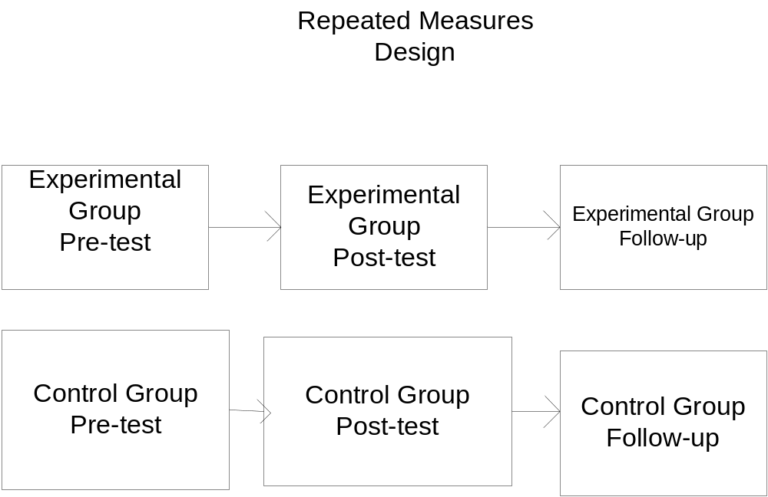
Repeated Observations are Within-Subjects effects
Trial 1 Trial 2 Trial 3
Group
Group is a between subjects effect, whereas Trial is a
within subjects effect.

Slide 14
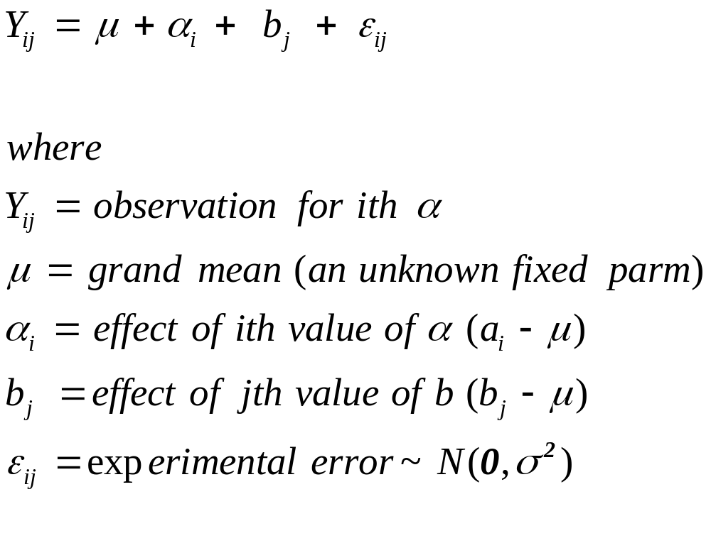
The General
Linear Model
The main effects general linear model can be parameterized as

Slide 15
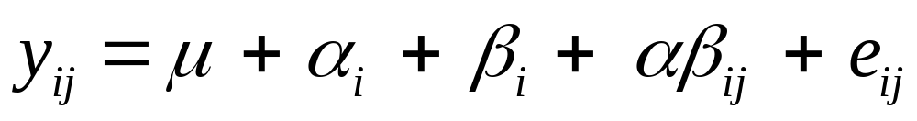
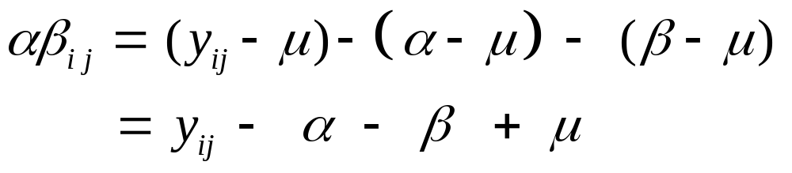
A factorial model
If an interaction term were included, the formula would be
The interaction or crossed effect is the joint effect, over and above the individual main effects. Therefore, the main effects
must be in the model for the interaction to be properly specified.

Slide 16
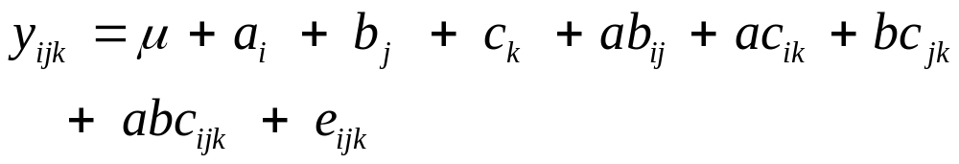
Higher-Order Interactions
If 3-way interactions are in the model, then the main effects and all lower order interactions must be in the model for the 3-way interaction to be properly specified. For example, a
3-way interaction model would be:

Slide 17
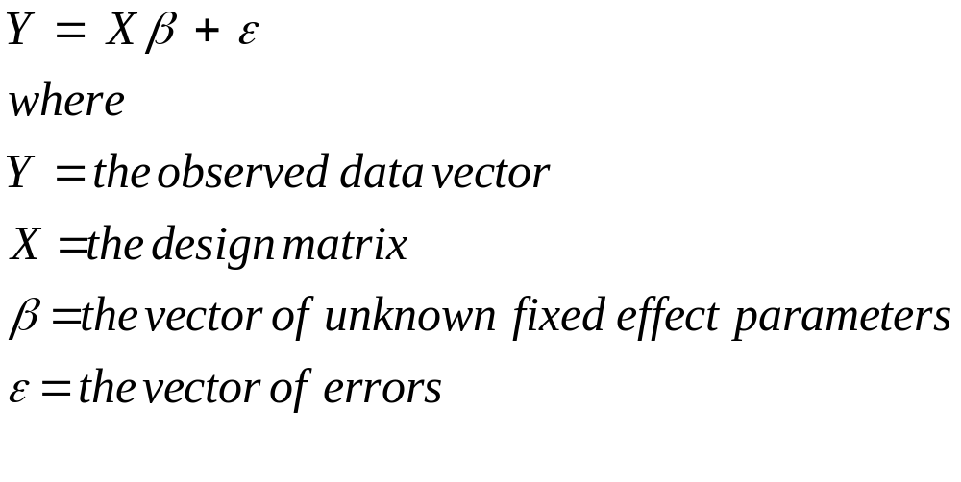
The General Linear Model
In matrix terminology, the general linear model may be expressed as

Slide 18
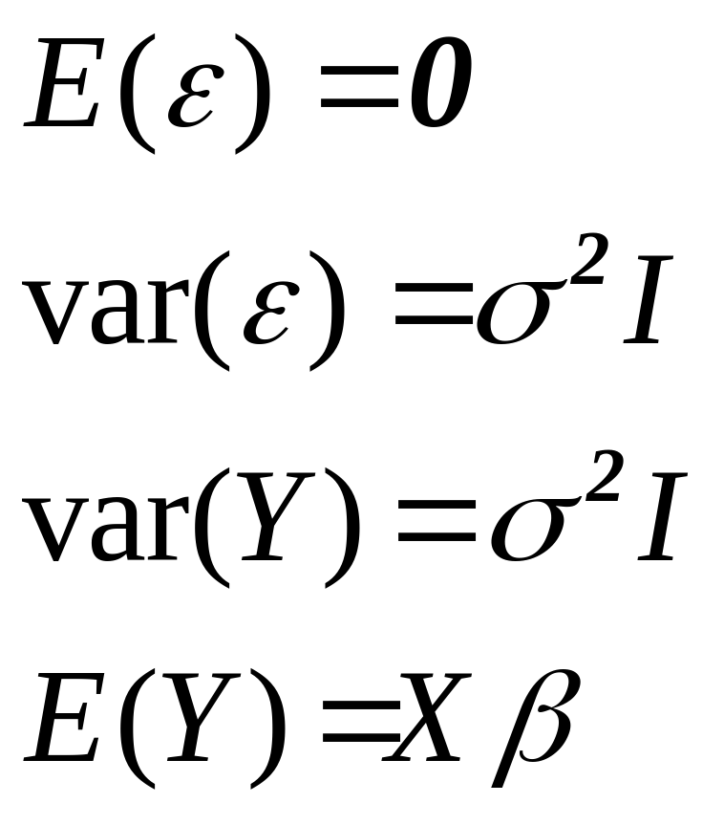
Assumptions
Of the general linear model

Slide 19
General Linear Model Assumptions-cont’d
1. Residual Normality.
2. Homogeneity of error variance
3. Functional form of Model: Linearity of Model
4. No Multicollinearity
5. Independence of observations
6. No autocorrelation of errors
7. No influential outliers
We have to test for these to be sure that the model is
valid.
We will discuss the robustness of the model in face
of violations of these assumptions.
We will discuss recourses when these assumptions are
violated.

Slide 20
Explanation of these assumptions
Functional form of Model: Linearity of Model: These models only analyze the linear relationship.
Independence of observations
Representativeness of sample
Residual Normality: So the alpha regions of the significance tests are properly defined.
Homogeneity of error variance: So the confidence limits may be easily found.
No Multicollinearity: Prevents efficient estimation of the parameters.
No autocorrelation of errors: Autocorrelation inflates the R² ,F and t tests.
No influential outliers: They bias the parameter estimation.

Slide 21
Diagnostic tests for these assumptions
Functional form of Model: Linearity of Model: Pair plot
Independence of observations: Runs test
Representativeness of sample: Inquire about sample design
Residual Normality: SK or SW test
Homogeneity of error variance Graph of Zresid * Zpred
No Multicollinearity: Corr of X
No autocorrelation of errors: ACF
No influential outliers: Leverage and Cook’s D.

Slide 22
Testing for outliers
Frequencies analysis of stdres cksd.
Look for standardized residuals greater than 3.5 or less than – 3.5
And look for Cook’s D.

Slide 23
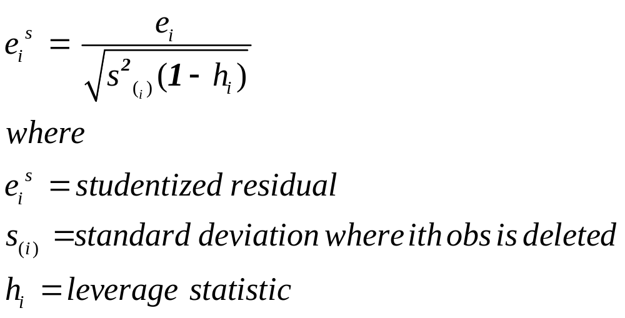
Studentized Residuals
Belsley et al (1980) recommend the use of studentized
Residuals to determine whether there is an outlier.

Slide 24
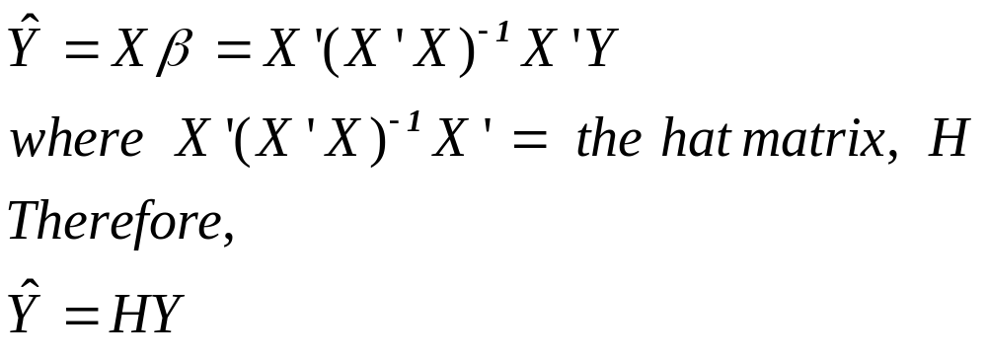
Influence of Outliers
Leverage is measured by the diagonal components of the hat matrix.
The hat matrix comes from the formula for the regression of Y.

Slide 25
Leverage and the Hat matrix
The hat matrix transforms Y into the predicted scores.
The diagonals of the hat matrix indicate which values will be outliers or not.
The diagonals are therefore measures of leverage.
Leverage is bounded by two limits: 1/n and 1. The closer the leverage is to unity, the more leverage the value has.
The trace of the hat matrix = the number of variables in the model.
When the leverage > 2p/n then there is high leverage according to Belsley et al. (1980) cited in Long, J.F. Modern Methods of Data Analysis (p.262). For smaller samples, Vellman and Welsch (1981) suggested that 3p/n is the criterion.

Slide 26
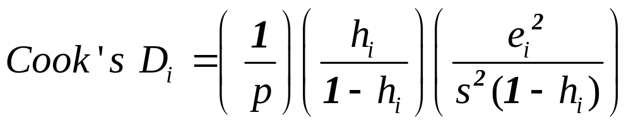
Cook’s D
Another measure of influence.
This is a popular one. The formula for it is:
Cook and Weisberg(1982) suggested that values of
D that exceeded 50% of the F distribution (df = p, n-p)
are large.

Slide 27
Cook’s D in SPSS
Finding the influential outliers
Select those observations for which cksd > (4*p)/n
Belsley suggests 4/(n-p-1) as a cutoff
If cksd > (4*p)/(n-p-1);

Slide 28
What to do with outliers
1. Check coding to spot typos
2. Correct typos
3. If observational outlier is correct, examine the dffits option to see the influence on the fitting statistics.
4. This will show the standardized influence of the observation on the fit. If the influence of the outlier is bad, then consider removal or replacement of it with imputation.

Slide 29
Decomposition of the Sums of Squares
Mean deviations are computed when means are subtracted from individual scores.
  This is done for the total, the group mean, and the error terms.
Mean deviations are squared and these are called sums of squares
Variances are computed by dividing the Sums of Squares by their degrees of freedom.
The total Variance = Model Variance + error variance

Slide 30
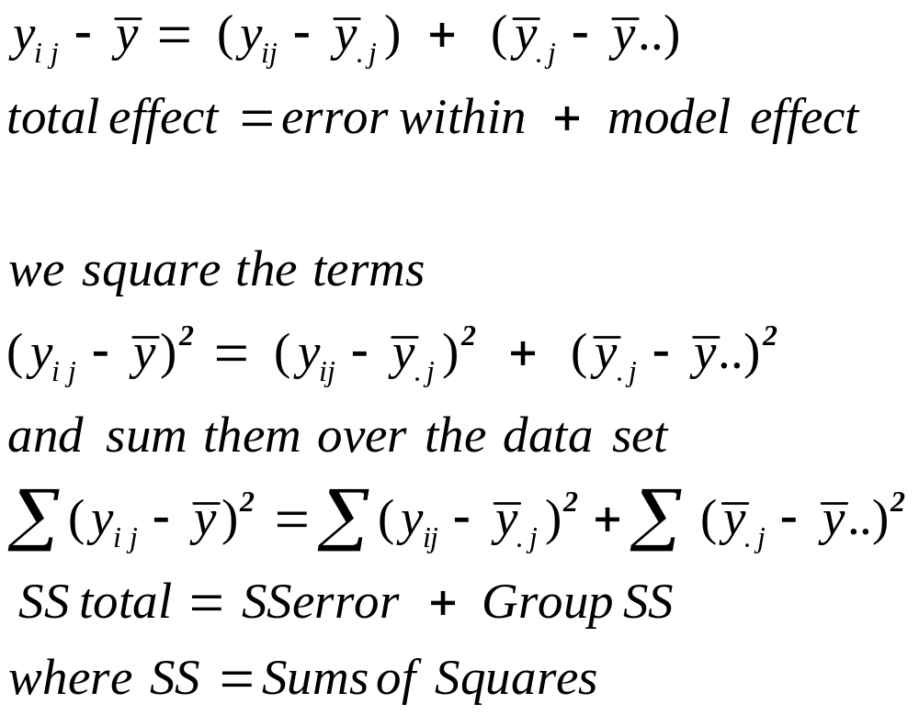
Formula for Decomposition of Sums of Squares
SS total = SS error + SSmodel

Slide 31
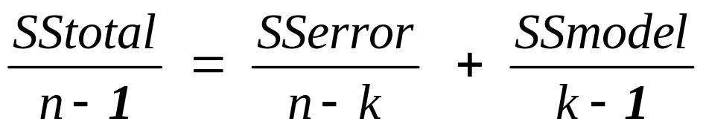
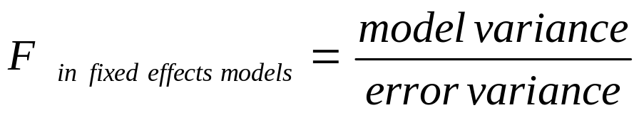
Variance Decomposition
Dividing each of the sums of squares by their respective degrees of freedom yields the variances.
Total variance= error variance
  + model variance.

Slide 32
Proportion of Variance Explained
R² = proportion of variance explained.
SStotal = SSmodel + SSerrror
Divide all sides by SStotal
SSmodel/SStotal
=1 - SSError/SStotal
R²=1 - SSError/SStotal

Slide 33
The Omnibus F test
The omnibus F test is a test that all of the means of the
levels of the main effects and
as well as any interactions specified
are not significantly different from one another.
Suppose the model is a one way anova on breaking
pressure of bonds of different metals.
Suppose there are three metals: nickel, iron, and
Copper.
H₀: Mean(Nickel)= mean (Iron) = mean(Copper)
H_{a}: Mean(Nickel) ne Mean(Iron) or
Mean(Nickel) ne Mean(Copper)
or Mean(Iron) ne Mean(Copper)

Slide 34
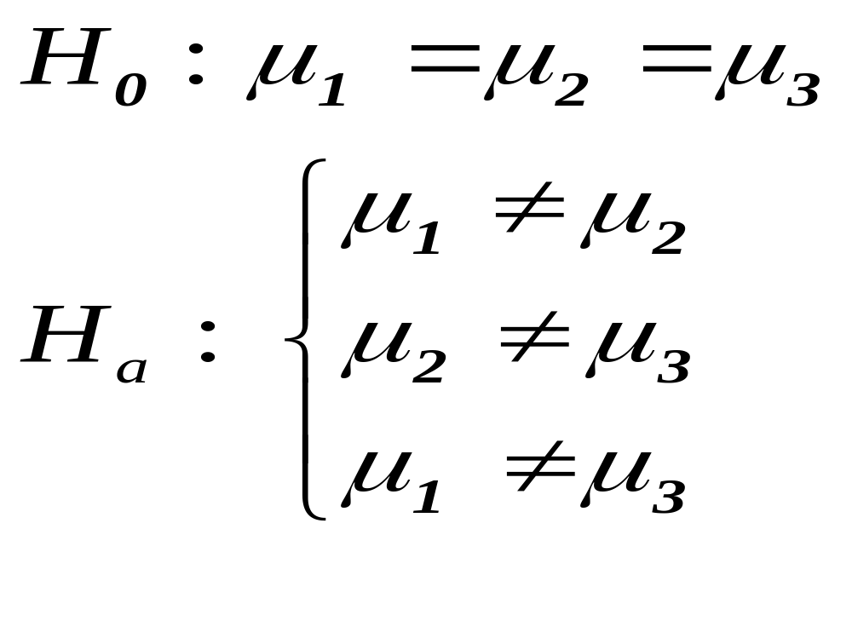
Testing different Levels of a Factor against one another
Contrast are tests of the mean of one level of a factor against other levels.

Slide 35
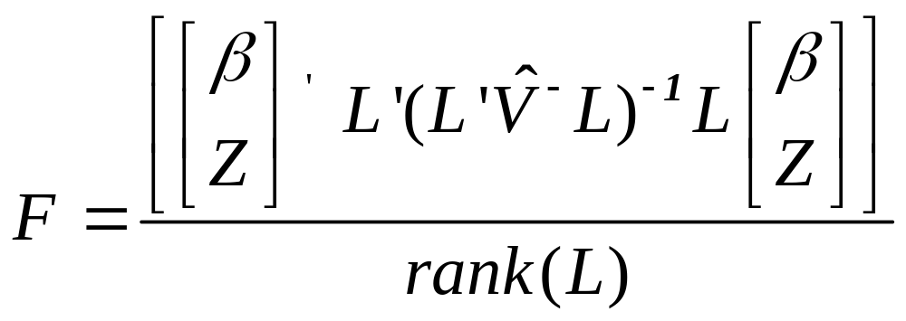
Contrasts-cont’d
A contrast statement computes
The estimated V⁻ is the generalized inverse of the
coefficient matrix of the mixed model.
The L vector is the k’b vector.
The numerator df is the rank(L) and the denominator
df is taken from the fixed effects table unless otherwise
specified.

Slide 36
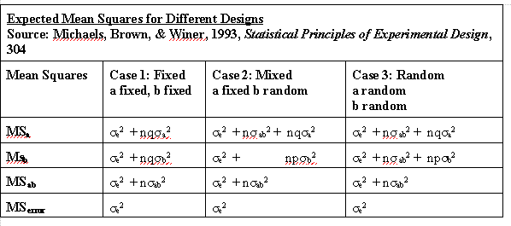
Construction of the F tests in different models
The F test is a ratio of two variances (Mean Squares).
It is constructed by dividing the MS of the effect to be
tested by a MS of the denominator term. The division
should leave only the effect to be tested left over as a remainder.
A Fixed Effects model F test for a = MSa/MSerror.
A Random Effects model F test for a = MSa/MSab
A Mixed Effects model F test for b = MSa/MSab
A Mixed Effects model F test for ab = MSab/MSerror

Slide 37
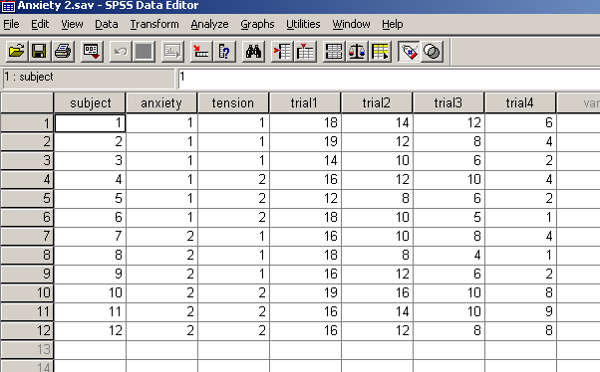
Data format
The data format for a GLM is that of wide data.

Slide 38
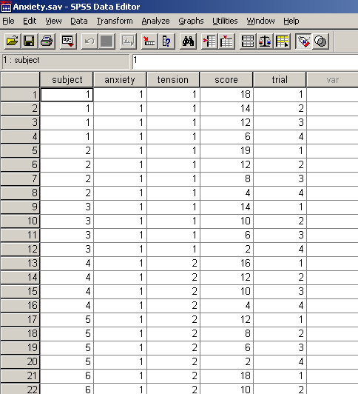
Data Format for Mixed Models is Long

Slide 39
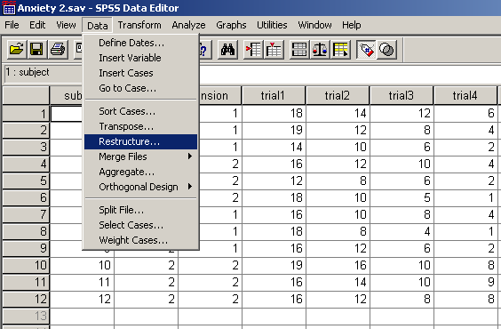
Conversion of Wide to Long Data Format
Click on Data in the header bar
Then click on Restructure in the pop-down menu

Slide 40
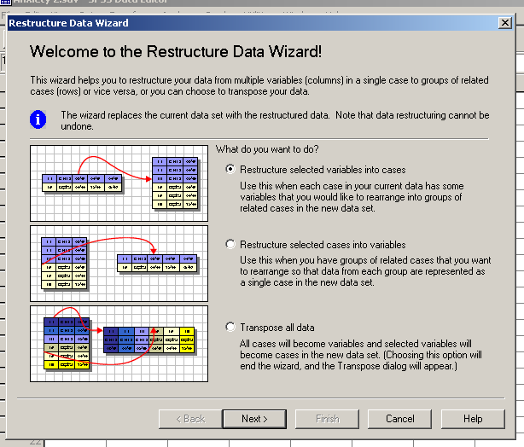
A restructure wizard appears
Select restructure selected variables into cases
and click on Next

Slide 41
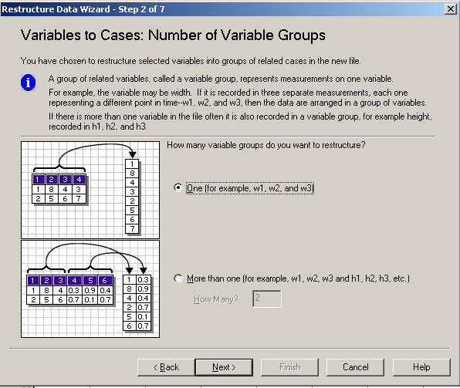
A Variables to Cases: Number of Variable Groups dialog box appears. We select one and click on next.

Slide 42
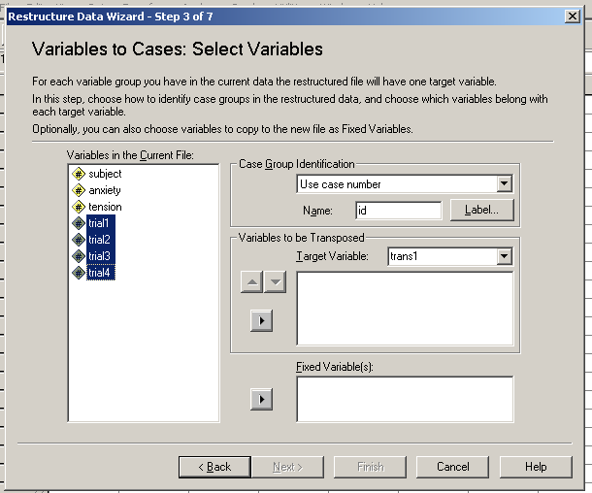
We select the repeated variables and move them to the target variable box

Slide 43
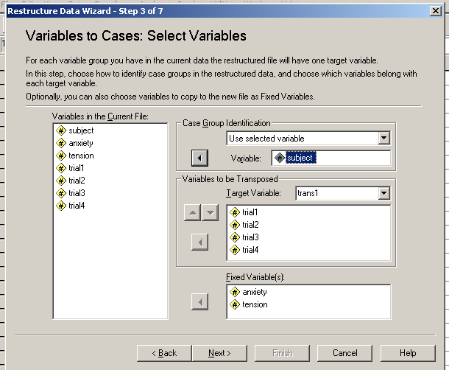
After moving the repeated variables into the target variable box, we move the fixed variables into the Fixed variable box, and select a variable for case id—in this case, subject.
Then we click on Next

Slide 44
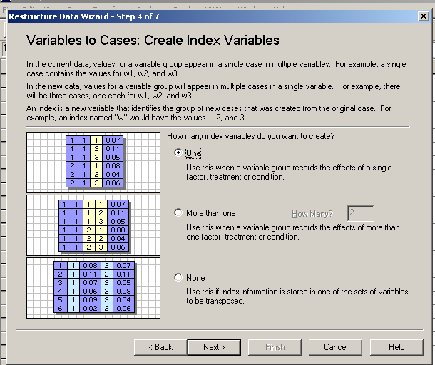
A create index variables dialog box appears. We leave the number of index variables to be created at one and click on next at the bottom of the box

Slide 45
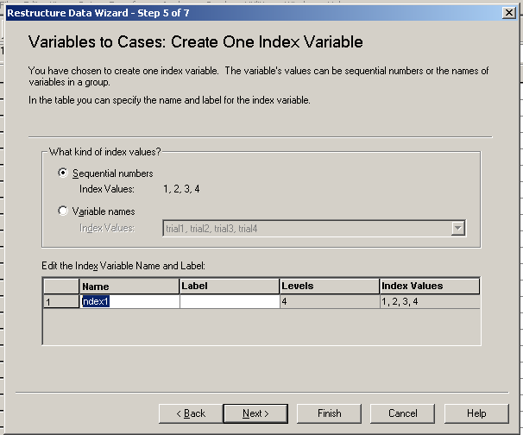
When the following box appears we just type in time and select Next.

Slide 46
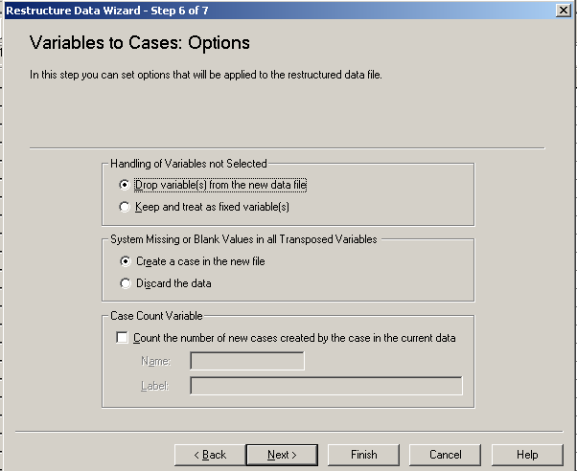
When the options dialog box appears, we select the option for dropping variables not selected.
We then click on Finish.

Slide 47
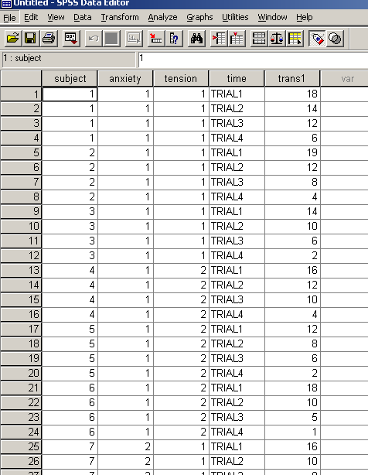
We thus obtain our data in long format

Slide 48
The Mixed Model
The Mixed Model uses long data format. It includes fixed and random effects.
It can be used to model merely fixed or random effects, by zeroing out the other parameter vector.
The F tests for the fixed, random, and mixed models differ.
Because the Mixed Model has the parameter vector for both of these and can estimate the error covariance matrix for each, it can provide the correct standard errors for either the
fixed or random effects.

Slide 49
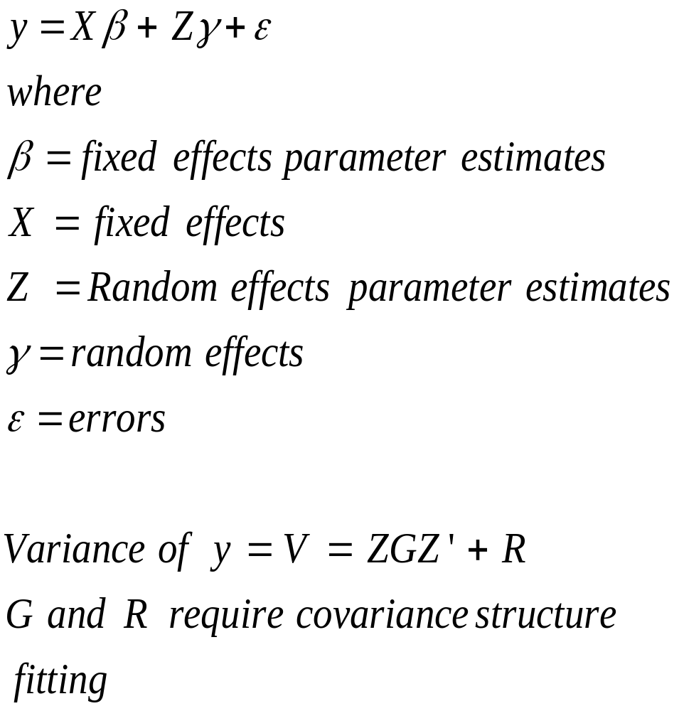
The Mixed Model

Slide 50
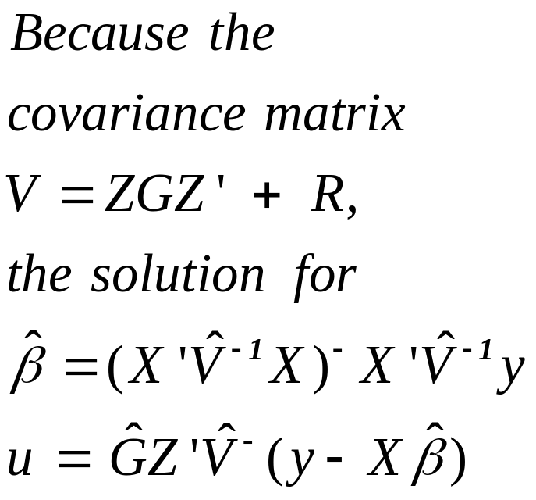
Mixed Model Theory-cont’d
Little et al.(p.139) note that u and e are uncorrelated random variables with 0 means and covariances, G and R, respectively.
V⁻ is a generalized inverse. Because V is usually singular and noninvertible AVA = V⁻ is an augmented matrix that is invertible. It can later be transformed back to V.
The G and R matrices must be positive definite.
In the Mixed procedure, the covariance type of the random (generalized) effects defines the structure of G and a repeated covariance type defines structure of R.

Slide 51
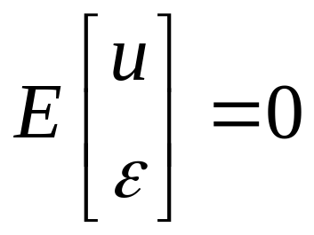
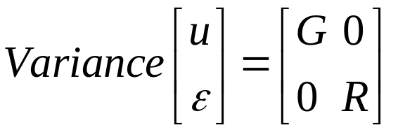
Mixed Model Assumptions
A linear relationship between dependent and independent variables

Slide 52
Random Effects Covariance Structure
This defines the structure of the G matrix, the random effects, in the mixed model.
Possible structures permitted by current version of SPSS:
  Scaled Identity
  Compound Symmetry
  AR(1)
  Huynh-Feldt

Slide 53
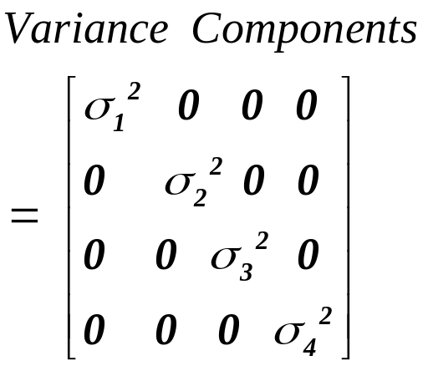
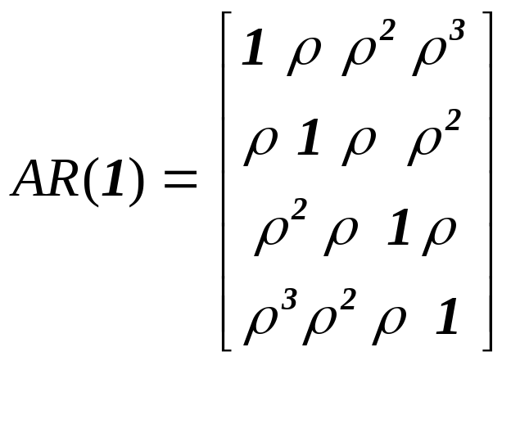
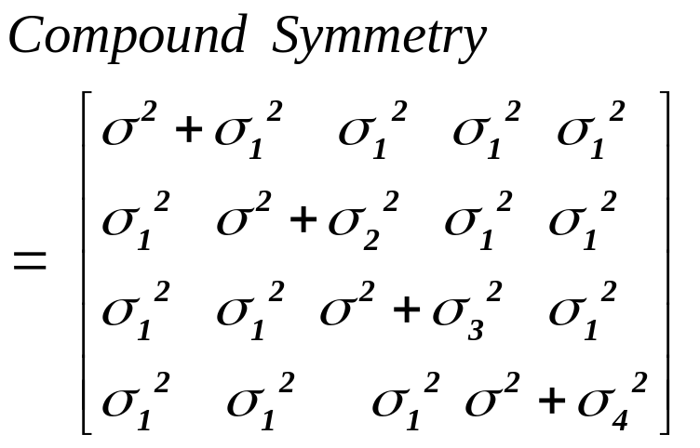
Structures of Repeated effects (R matrix)-cont’d

Slide 54
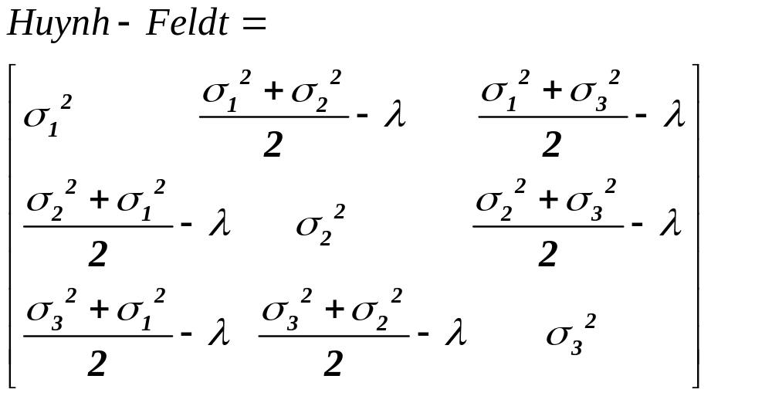
Structures of Repeated Effects (R matrix)

Slide 55
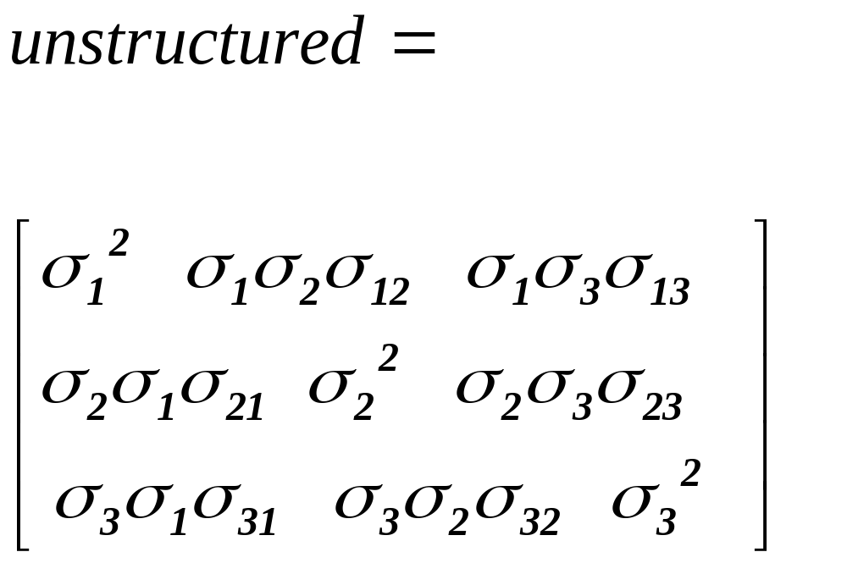
Structures of Repeated effects (R matrix) –con’td

Slide 56
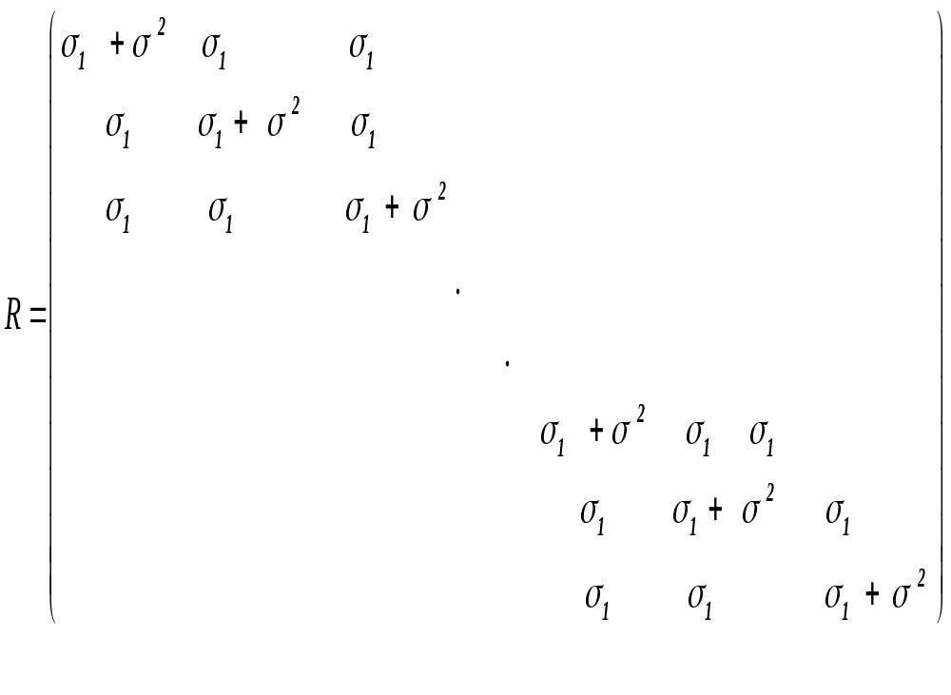
R matrix, defines the correlation among repeated random effects
One can specify the nature of the correlation among the
repeated random effects.

Slide 57


GLM Mixed Model
The General Linear Model is a special case of the
Mixed Model with Z = 0 (which means that
Zu disappears from the model) and

Slide 58
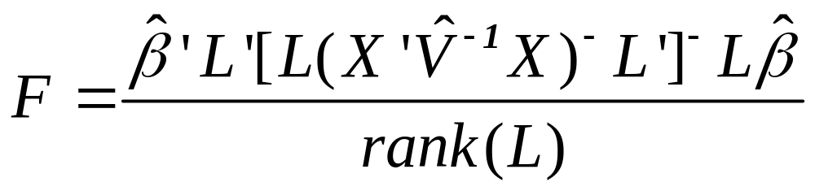
Mixed Analysis of a Fixed Effects model
SPSS tests these fixed effects just as it does with the GLM
Procedure with type III sums of squares.
We analyze the breaking pressure of bonds made
from three metals. We assume that we do not
generalize beyond our sample and that our
effects are all fixed.
Tests of Fixed Effects is performed with the help of
the L matrix by constructing the following F test:
Numerator df = rank(L)
Denominator df = RESID (n-rank(X)
df = Satherth

Slide 59
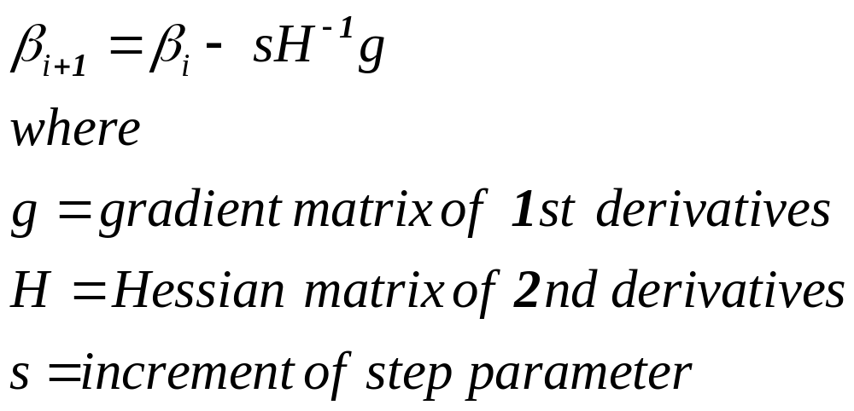
Estimation: Newton Scoring

Slide 60
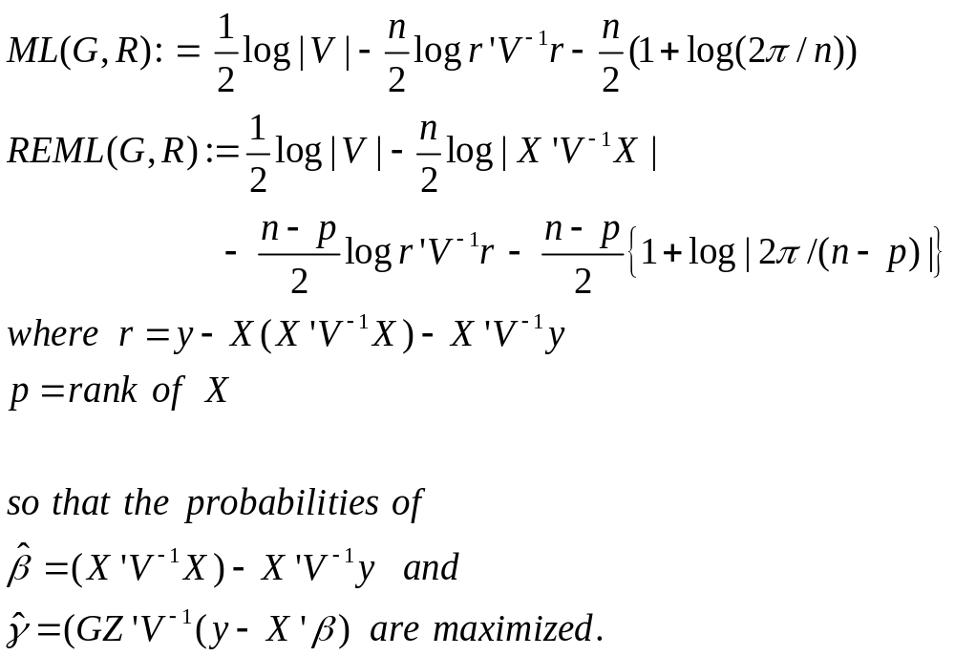
Estimation: Minimization of the objective functions
Using Newton Scoring, the following functions are minimized

Slide 61
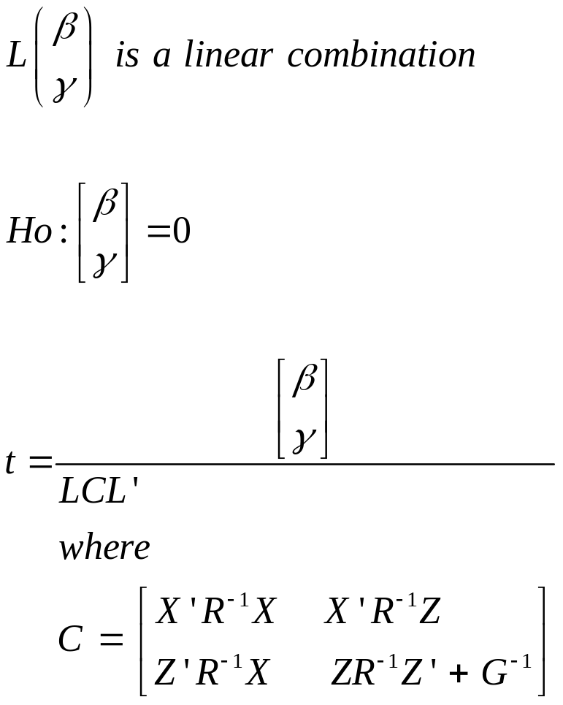
Significance of Parameters

Slide 62
Test one covariance structure against the other with the IC
The rule of thumb is smaller is better
-2LL
AIC Akaike
AICC Hurvich and Tsay
BIC Bayesian Info Criterion
Bozdogan’s CAIC

Slide 63
Measures of Lack of fit: The information Criteria
-2LL is called the deviance. It is a measure of sum of squared errors.
AIC = -2LL + 2p (p=# parms)
BIC = Schwartz Bayesian Info criterion = 2LL + plog(n)
AICC= Hurvich and Tsay’s small sample correction on AIC: -2LL + 2p(n/(n-p-1))
CAIC = -2LL + p(log(n) + 1)

Slide 64
Procedures for Fitting the Mixed Model
One can use the LR test or the lesser of the information criteria. The smaller the information criterion, the better the model happens to be.
We try to go from a larger to a smaller information criterion when we fit the model.

Slide 65
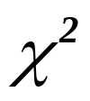
LR test
To test whether one model is significantly better than the other.
To test random effect for statistical significance
To test covariance structure improvement
To test both.
Distributed as a
With df= p₂ – p₁ where p_{i} =# parms in model i

Slide 66
Applying the LR test
We obtain the -2LL from the unrestricted model.
We obtain the -2LL from the restricted model.
We subtract the latter from the larger former.
That is a chi-square with df= the difference in the number of parameters.
We can look this up and determine whether or not it is statistically significant.

Slide 67
Advantages of the Mixed Model
It can allow random effects to be properly specified and computed, unlike the GLM.
It can allow correlation of errors, unlike the GLM. It therefore has more flexibility in modeling the error covariance structure.
It can allow the error terms to exhibit nonconstant variability, unlike the GLM, allowing more flexibility in modeling the dependent variable.
It can handle missing data, whereas the repeated measures GLM cannot.

Slide 68
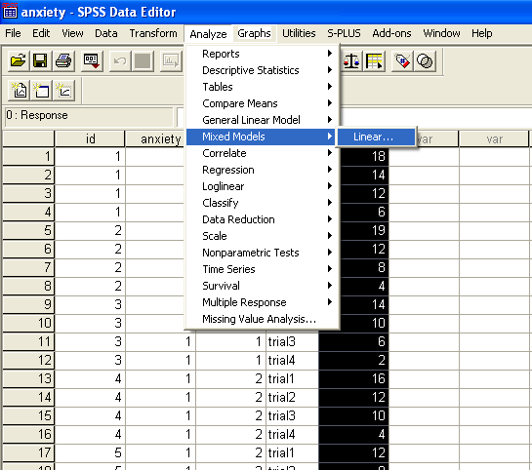
Programming A Repeated Measures ANOVA with PROC Mixed
Select the Mixed Linear Option in Analysis

Slide 69
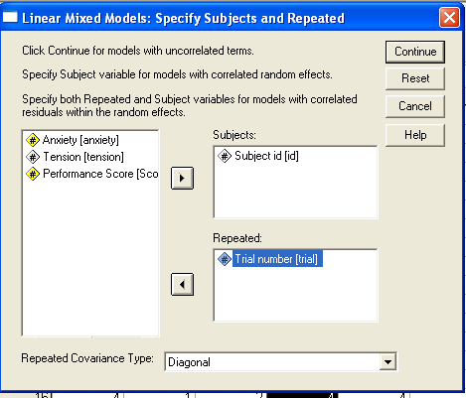
Move subject ID into the subjects box and the repeated variable into the repeated box.
Click on continue

Slide 70
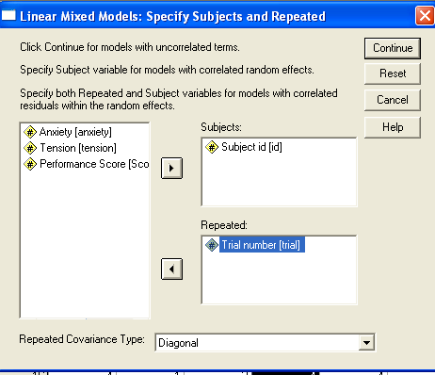
We specify subjects and repeated effects with the next dialog box
We set the repeated covariance type to “Diagonal”
& click on continue

Slide 71
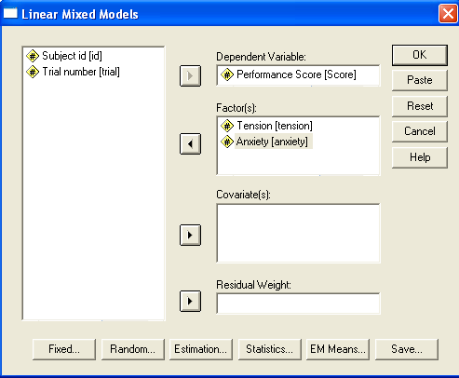
Defining the Fixed Effects
When the next dialog box appears, we insert the dependent Response variable and the fixed effects of anxiety and tension
Click on continue

Slide 72
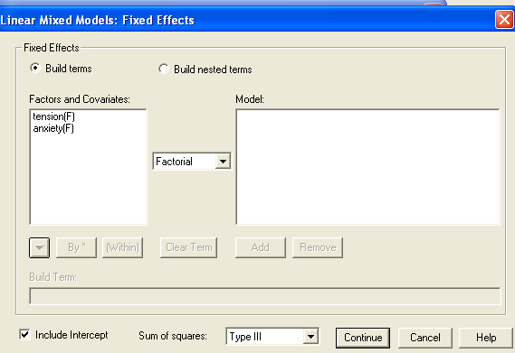
We select the Fixed effects to be tested

Slide 73
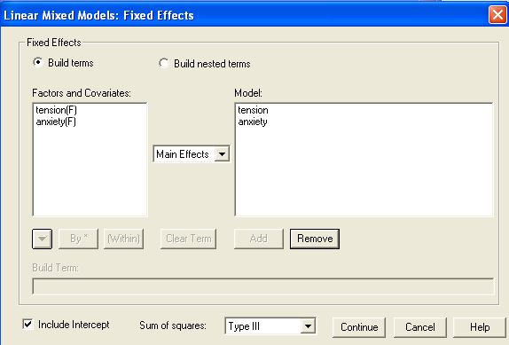
Move them into the model box, selecting main effects, and type III sum of squares
Click on continue

Slide 74

When the Linear Mixed Models dialog box appears, select random

Slide 75

Under random effects, select scaled identity as covariance type and move subjects over into combinations
Click on continue

Slide 76

Select Statistics and check of the following in the dialog box that appears
Then click continue

Slide 77
When the Linear Mixed Models box appears, click ok

Slide 78

You will get your tests

Slide 79

Estimates of Fixed effects and covariance parameters

Slide 80

R matrix

Slide 81
Rerun the model with different nested covariance structures and compare the information criteria
The lower the information criterion, the better fit the nested model has. Caveat: If the models are not nested, they cannot be compared with the information criteria.

Slide 82
GLM vs. Mixed
GLM has
means
lsmeans
sstype 1,2,3,4
estimates using OLS or WLS
one has to program the correct F tests for random effects.
losses cases with missing values.
Mixed has
lsmeans
sstypes 1 and 3
estimates using maximum likelihood, general methods of moments, or restricted maximum likelihood
ML
MIVQUE0
REML
gives correct std errors and confidence intervals for random effects
Automatically provides correct standard errors for analysis.
Can handle missing values

